Slide 1
Survivorship Bias
Sam Beighle and Reese Mcdonald

Slide 2
What We Will Cover
The definition of survivorship bias
Examples of where it is found
How it can be exploited
When it can work against us
How it relates to the content of Invisible Women

Slide 3
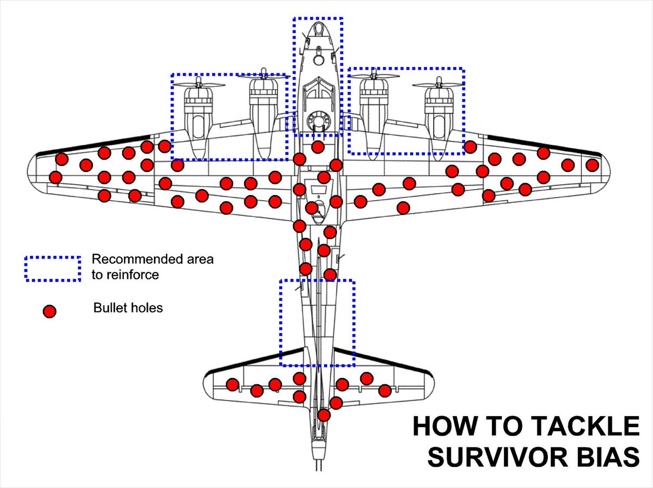
World War II
Planes that returned from battle had bullet holes (red) in the plane
They thought the logical answer was to add armor/strengthen areas of the plane that had bullet holes
Abraham Wald found that planes shot in the critical areas did not return (blue)
Added armor to blue areas, not red

Slide 4
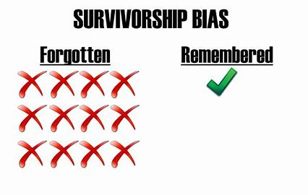
Survivorship Bias
Definition: The logical error of focusing on existing (surviving) observations and does not consider the failed or nonexistent observations.
Common in finance/business
Social Media
May create overly optimistic ideas
Fooled by success stories
Form of selection bias

Slide 5
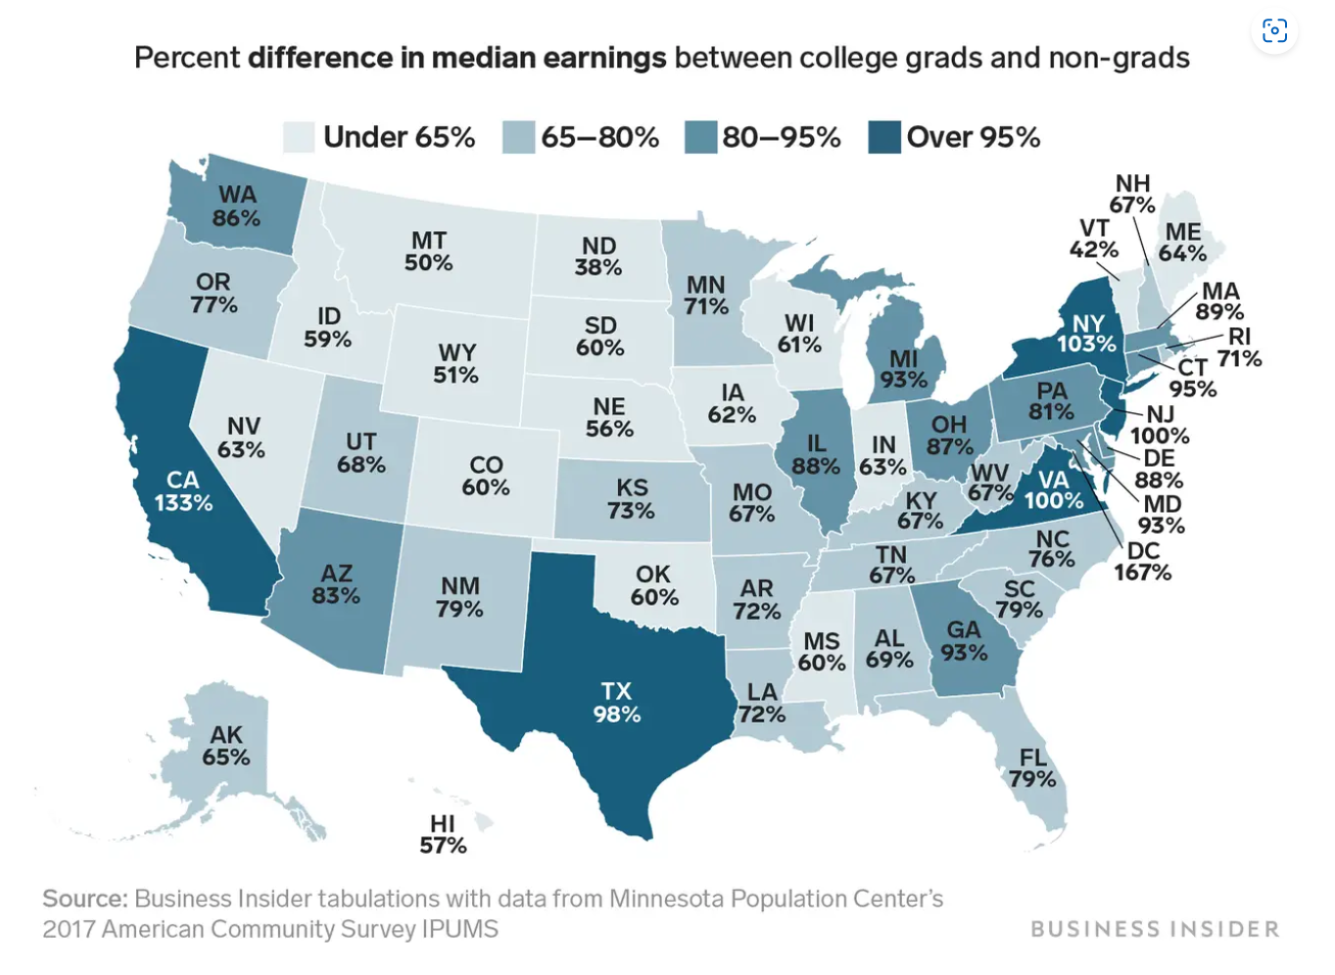
Better off Skipping College?
Following success stories
Mark Zuckerberg - Facebook
Bill Gates - Microsoft
Non-graduates had double the unemployment rate
No college - 4.5%
College Graduate - 2.2%

Slide 6
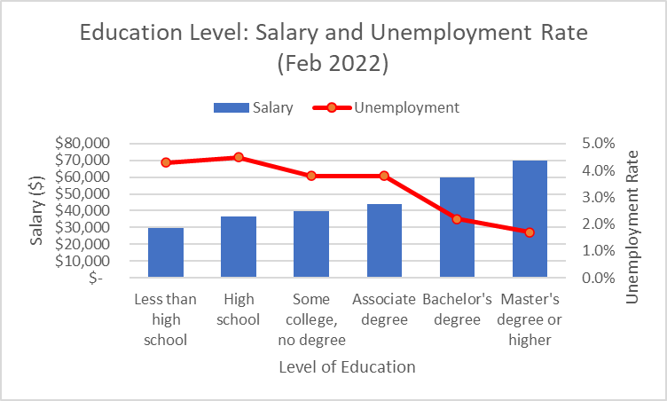
Level of Education and Unemployment Rate
As education level increases, salary increases and unemployment rate decreases
If you only focus on “successes” of skipping college, you miss what the data really shows

Slide 7
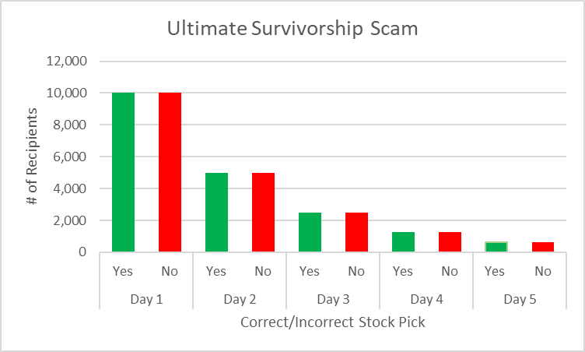
Taking Advantage of Survivorship Bias
Pick stock to go up or down and send each pick to half of the people
Next day, pick only correct recipients and send stock pick to go up or down to half again
Continue for entire week
Day 5 - half of the people receive a week’s worth of correct picks
Correct Picks for the Week

Slide 8
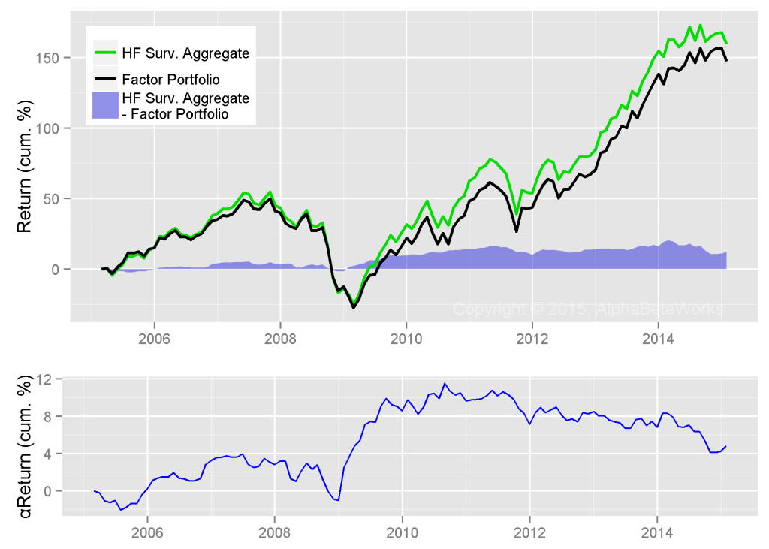
Hedge Fund Performance
Long equity portfolios of ~1000 non-quant HFs
Many investment firms select out data from failed mutual funds in overall profit reports
This results in an overly optimistic perception of their profitability
Surviving HF aggregate outperforms passive investment

Slide 9
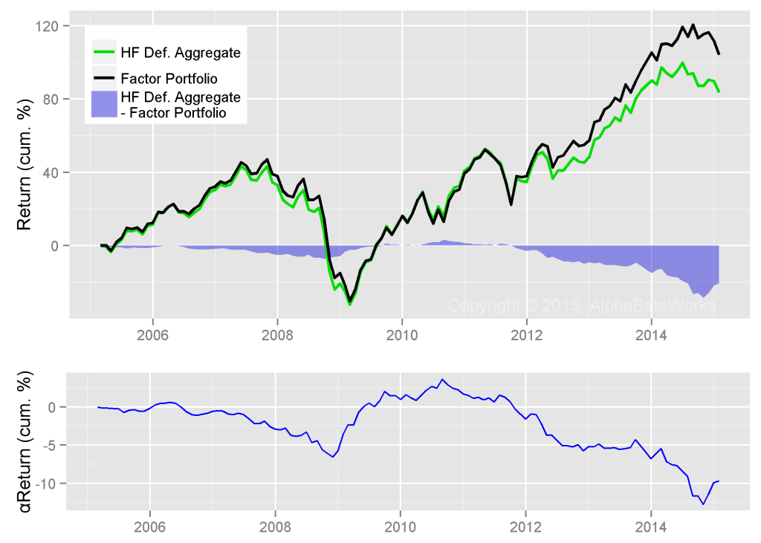
Hedge Fund Performance cont.
HF long portfolios underperform according to failed-fund inclusive data
Unwitting investors expect a higher return than is feasible
Surviving aggregate outperforms defunct aggregate by 70%
No way to know which funds will succeed or fail

Slide 10
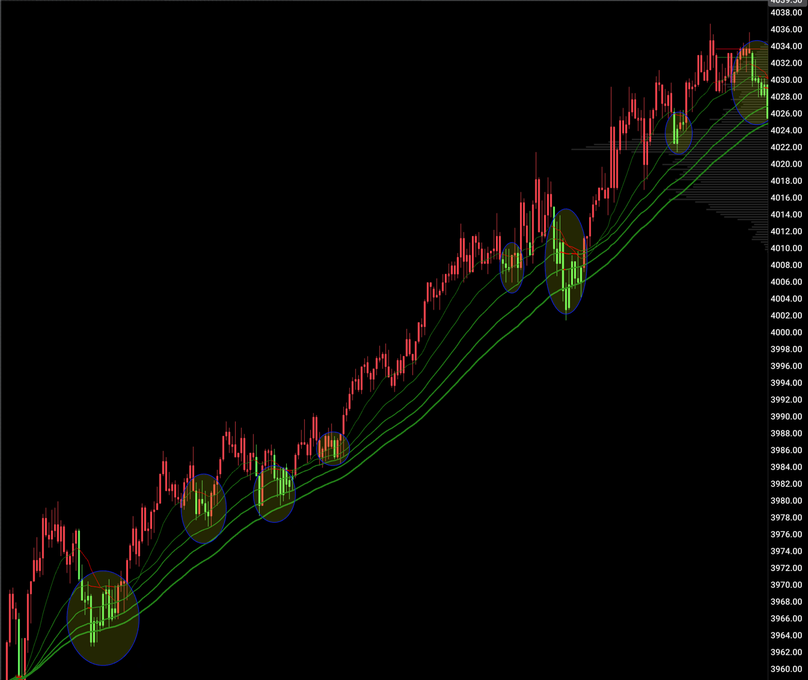
Survivorship Bias
in Trading
Following slides display S&P500 e-mini (ES) futures contract
Traders can suffer from survivorship bias
Technical analysis = pattern recognition
Rudimentary trend-following trading strategy

Slide 11
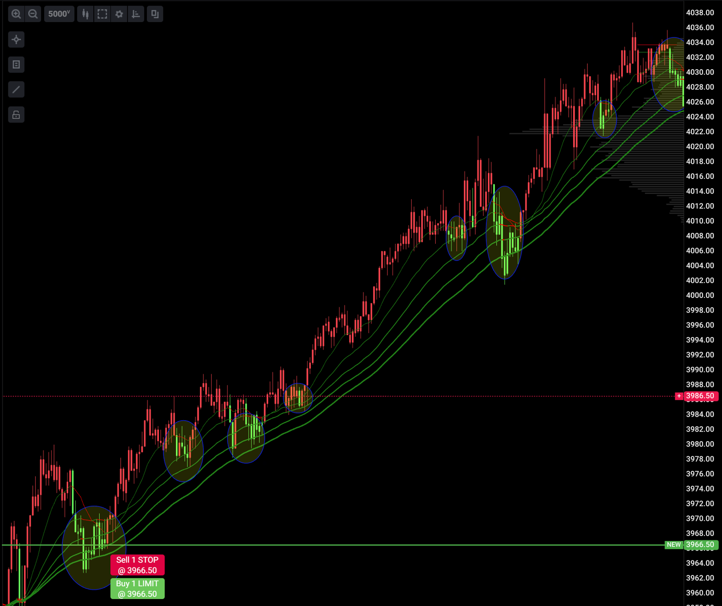
Survivorship Bias
in Trading
MAs have positive slope and candles turn green = go long
How many signals would convince you?
Do we go long on the last two signals?

Slide 12
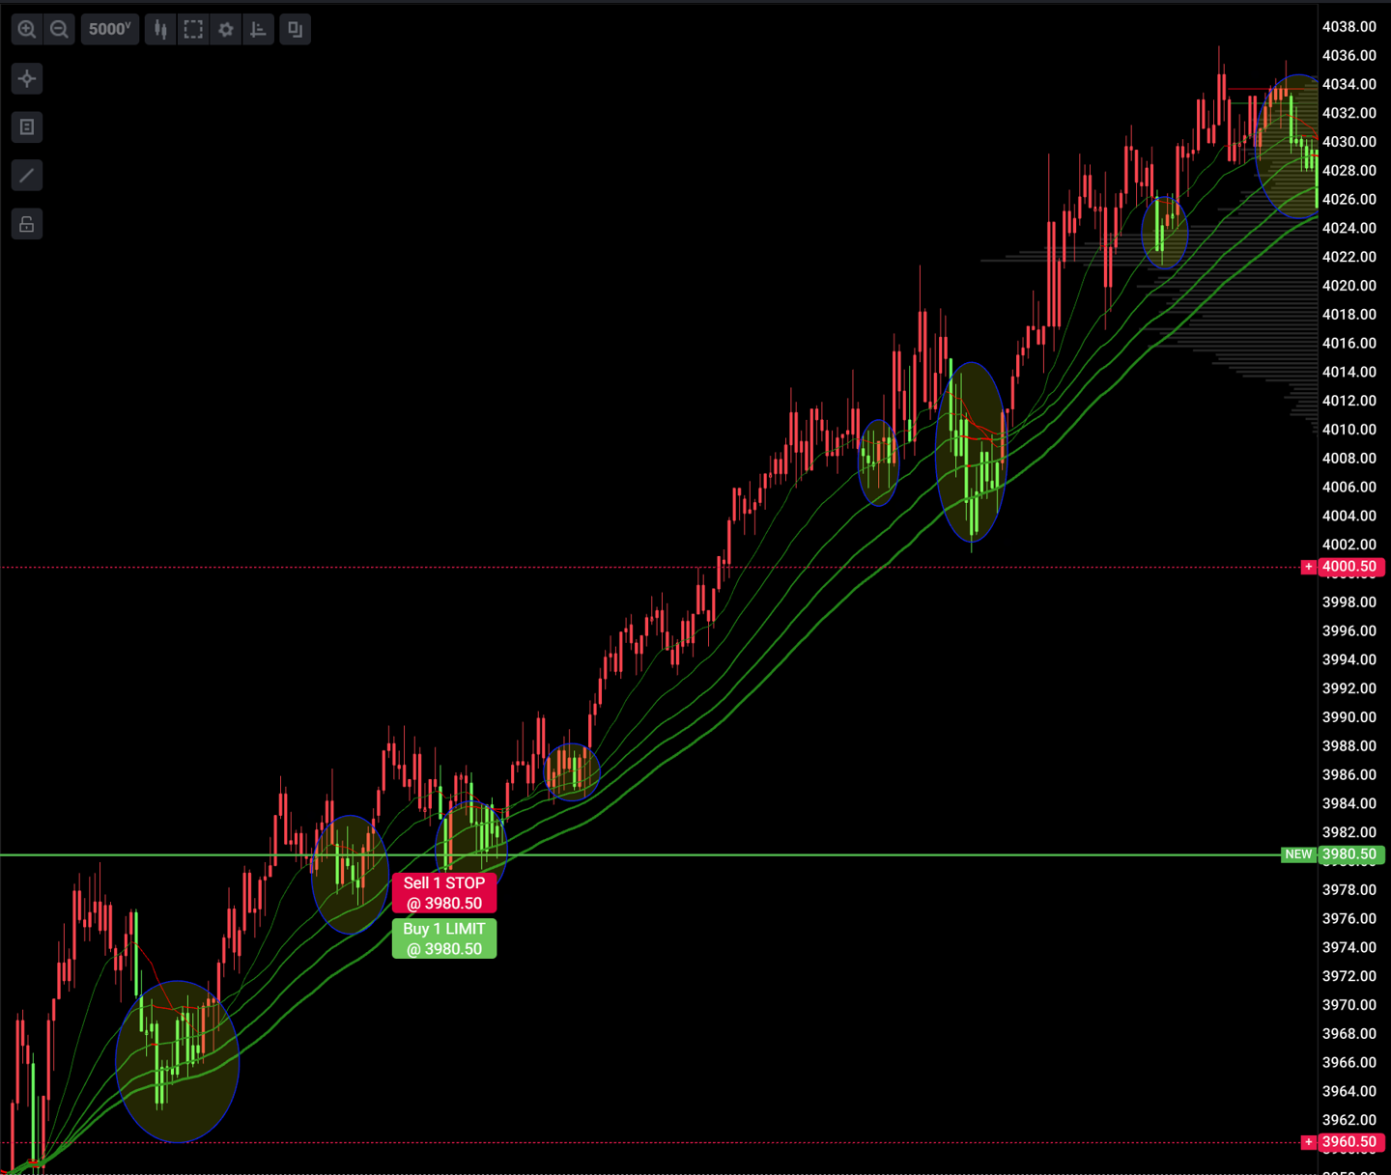
Survivorship Bias
in Trading
These are 1:1 risk:reward trades with 20 pts at stake ($1000)
The pattern and signal pay off

Slide 13
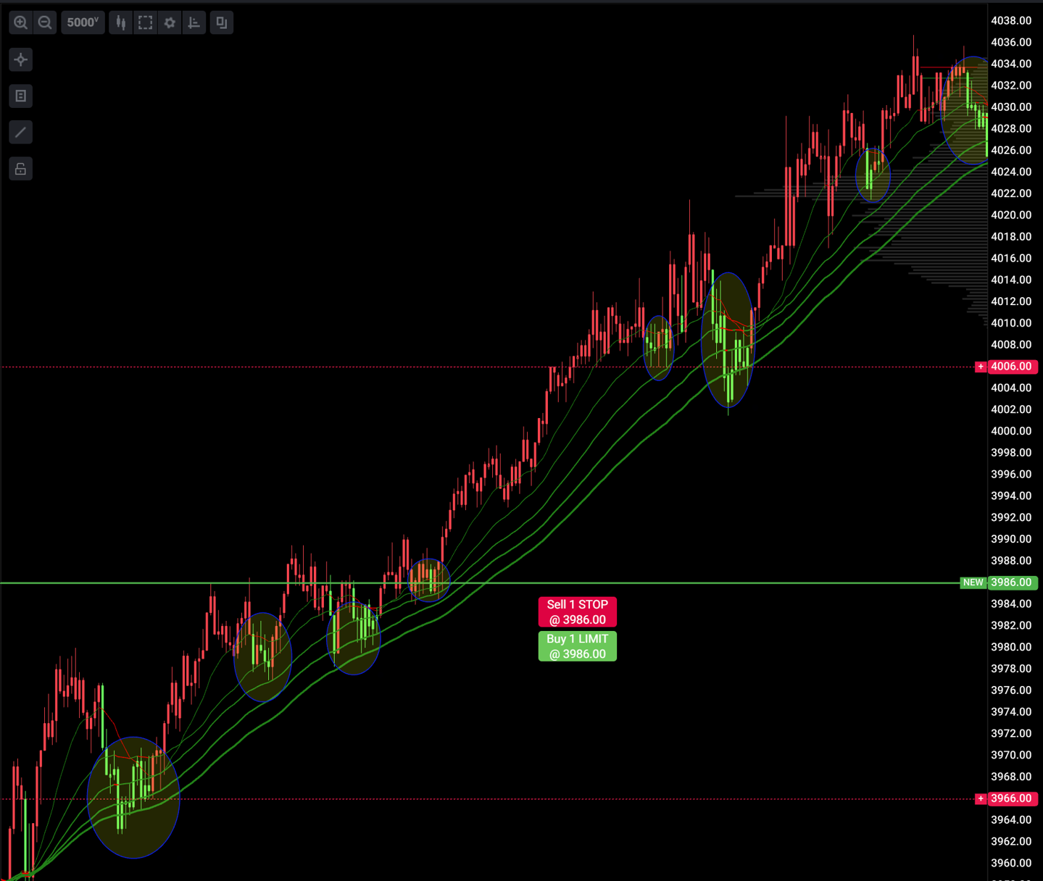
Survivorship Bias
in Trading
Another winner…

Slide 14
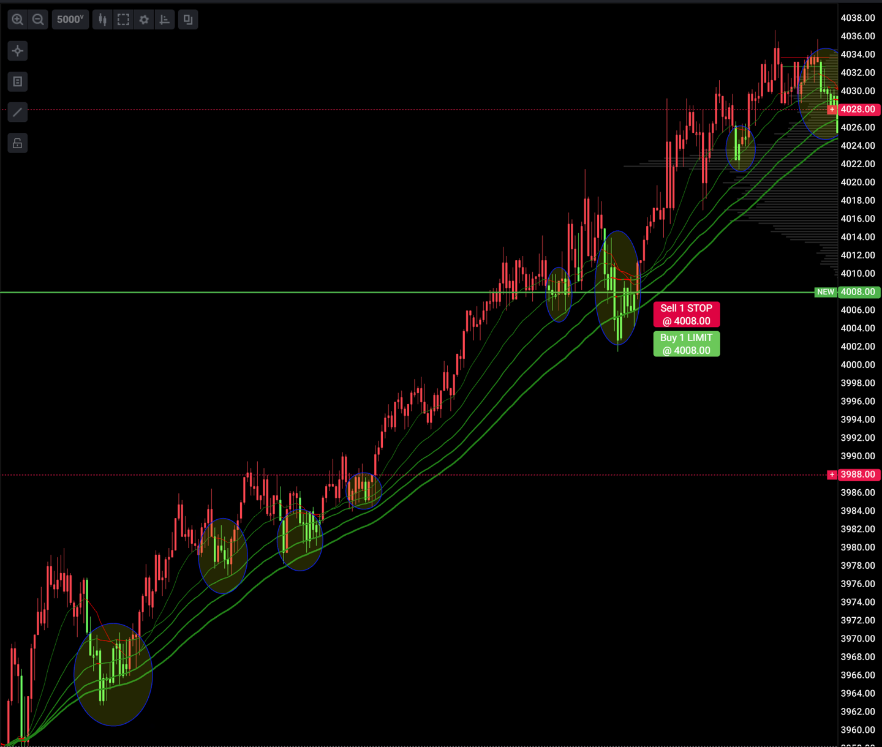
Survivorship Bias
in Trading
More winners had we taken the trades
The winning trades are “survivors”, or those selected into a mental model of the pattern
Traders who are new to this pattern may begin to make assumptions
Do we go long for 20 pts on the next two signals?

Slide 15
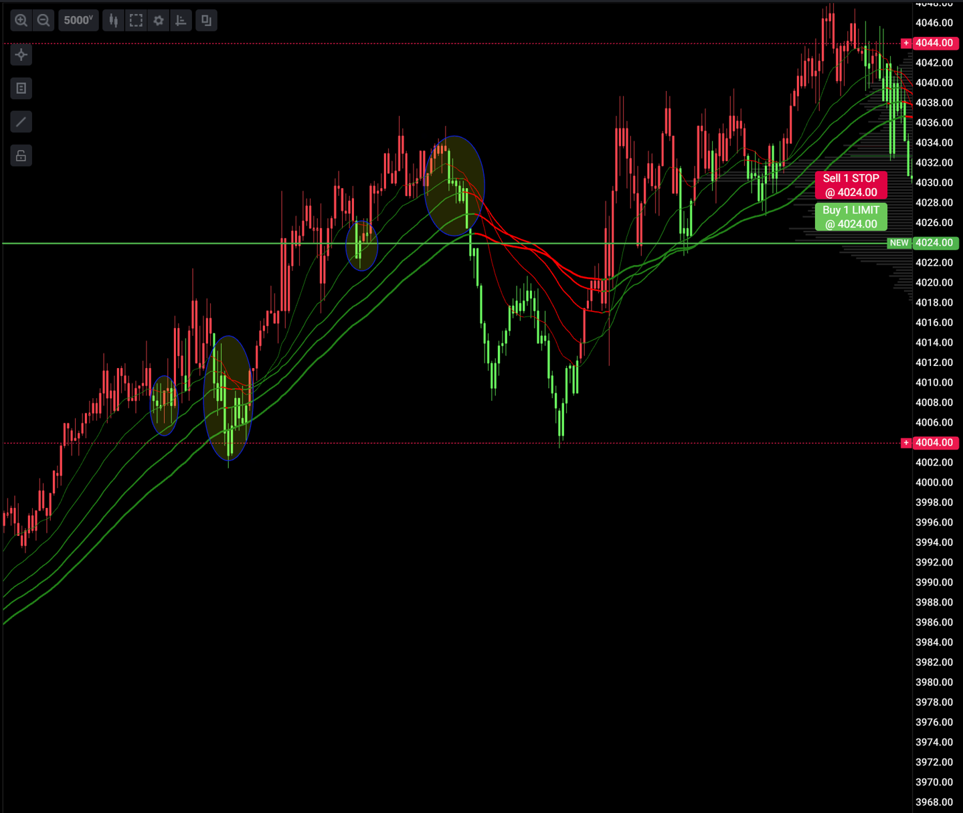
Survivorship Bias
in Trading
We had only considered the positive outcomes to this point
Once convinced, we go long and get stopped out (-$1000)
No pattern or system is 100% successful
Higher proportion of false signals leads to long-term losses

Slide 16
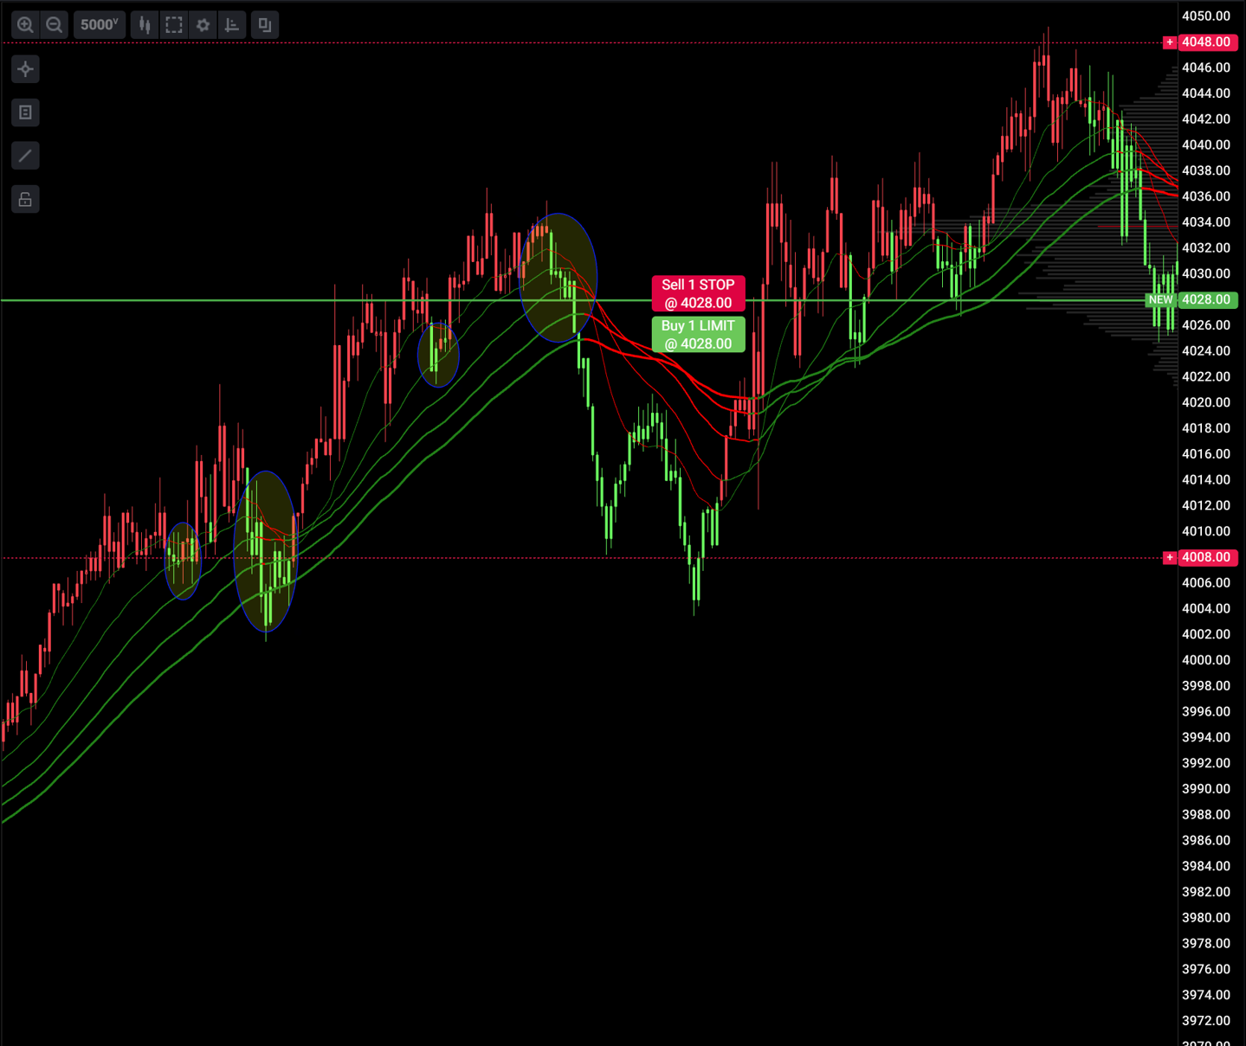
Survivorship Bias
in Trading
Test, record and analyze to avoid survivorship bias in trading
Thinking about the data that isn’t present and how to capture it is key
Strategy jumping and survivorship bias with losing trades as the “survivors”

Slide 17
What We’ve Covered
Definition & early recognition of survivorship phenomenon (WW2 bombers)
Examples in educational decision making
Potential abuses of the bias
Hedge funds help themselves
Survivorship bias pitfalls in trading
How it ties back to Invisible Women
Women systematically selected out of the data
Decision-makers overlook their needs as a result

